Slide 1

Vel Tech Rangarajan Dr. Sagunthala R&D Institute of Science and Technology
School of Computing
Department of Computer Science and Engineering
10211CS224 / FULL STACK APPLICATION DEVELOPMENT (JAVA)
END SEMESTER PROJECT REVIEW
Date: 06-05-2026
Job Portal Management System
SDG No – SDG 8: Decent Work and Economic Growth
Presented By:
Pantangi Gowtham Siva Santhosh– VTU26659 – 23UECS0429
Courses Handling Faculty:
Dr. S.Hemamalini – Assistant Professor(Senior Grade)-M.E,Ph.D

Slide 2
INTRODUCTION
JobPortal is a web-based recruitment and placement management system designed to simplify and automate the hiring process
The system connects students, employers, and administrators on a single centralized platform
It provides role-based access where students can apply for jobs, employers can post vacancies, and admins manage the overall system
Built using Spring Boot, the platform ensures secure backend processing and efficient data handling
Integrated email/OTP services and chatbot support improve communication and user experience
The system minimizes manual work, increases transparency, and accelerates recruitment workflows.
This project represents a scalable and practical solution for modern campus and organizational hiring needs
1
2
3
4
5
6
7
8
9

Slide 3
PROBLEM STATEMENT
Current recruitment processes are often manual and time-consuming, leading to delays in hiring.
There is no centralized platform connecting students, employers, and administrators efficiently.
Students face difficulty in finding relevant job opportunities and tracking applications.
Employers struggle with managing large volumes of applications and shortlisting candidates.
Lack of real-time updates causes poor communication and transparency in recruitment.
Existing systems provide limited analytics and insights for decision-making.
Security concerns exist due to weak authentication and data handling mechanisms.
There is a need for a secure, automated, and intelligent recruitment system to improve efficiency and user experience.
1
2
3
4
5
6
7
8
9

Slide 4
OBJECTIVE(S)
To develop a centralized JobPortal system that connects students, employers, and administrators on a single platform.
To automate the recruitment process, including job posting, application tracking, and candidate management.
To ensure secure and efficient user authentication with role-based access control.
1
2
3
4
5
6
7
8
9

Slide 5
PROPOSED SYSTEM
The proposed system is a web-based JobPortal platform that automates the entire recruitment process.
It provides a centralized system connecting students, employers, and administrators.
Students can search, apply, and track job applications in real-time.
Employers can post job openings, manage applications, and shortlist candidates efficiently.
Admin manages users, monitors activities, and maintains system control.
The system uses secure authentication (JWT) and database integration for safe data handling.
Features like chatbot support and email/OTP notifications enhance user interaction.
Compared to existing systems, it offers automation, transparency, better communication, and improved efficiency.
1
2
3
4
5
6
7
8
9

Slide 6
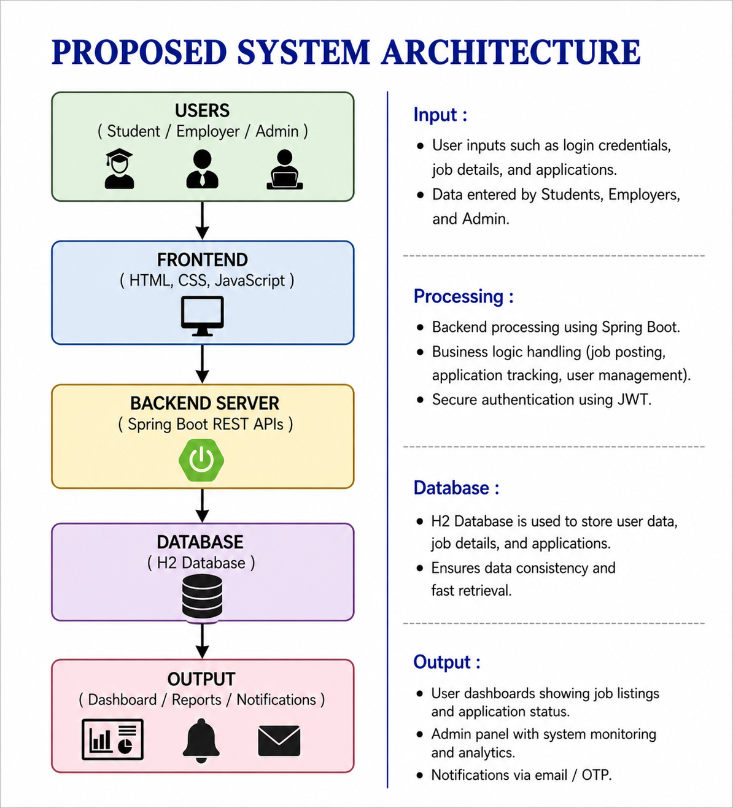
PROPOSED SYSTEM ARCHITECTURE
1
2
3
4
5
6
7
8
9

Slide 7
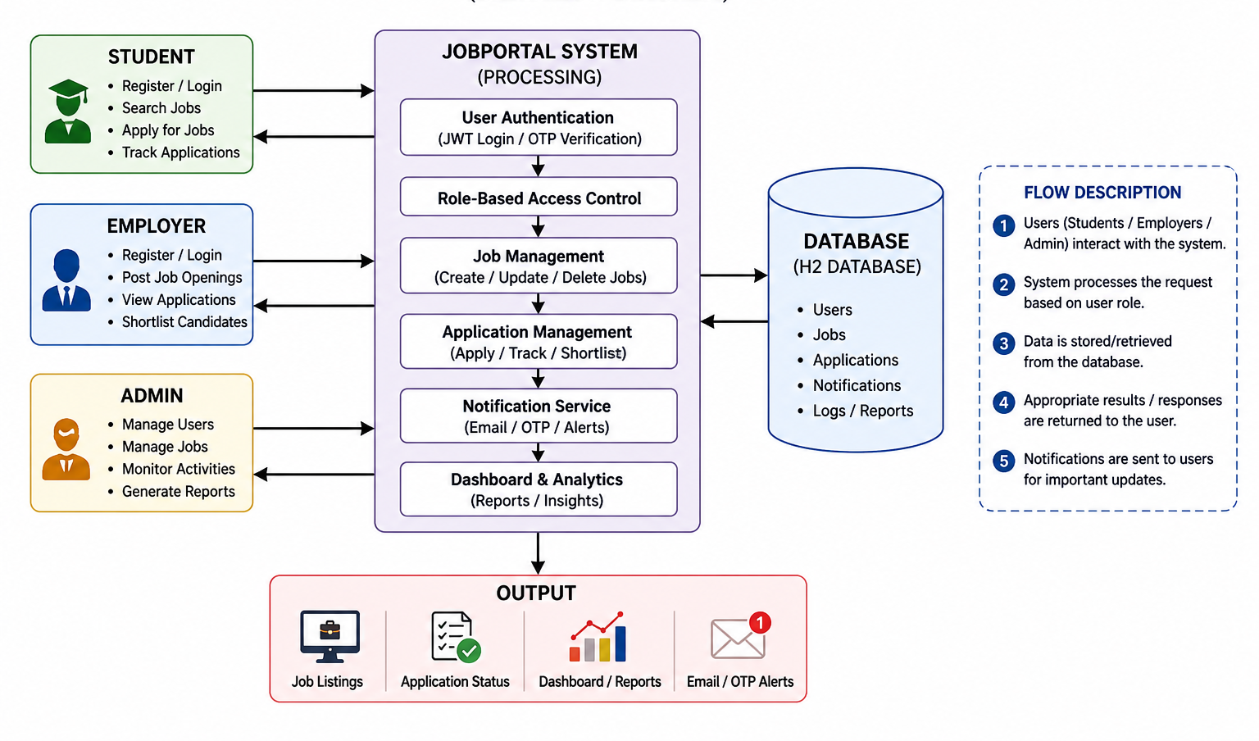
WORKFLOW
1
2
3
4
5
6
7
8
9

Slide 8
TECHNOLOGIES USED
Frontend: HTML, CSS, JavaScript
Backend: Spring Boot (Java)
Database: H2 Database
Third-Party API: Email Service (SMTP), Chatbot Integration
Tools: Git, GitHub, Maven, VS Code / Eclipse
Hardware/Software Requirements:
Java JDK 17
Web Browser (Chrome/Edge)
Minimum 4GB RAM
1
2
3
4
5
6
7
8
9

Slide 9
MODULE DESCRIPTION
Module 1: User Management Handles user registration, login, and role-based access (Student, Employer, Admin) with secure authentication using JWT and OTP.
Module 2: Job Management Allows employers to create, update, and manage job postings, and enables students to search and view job opportunities.
Module 3: Application Management Manages job applications where students can apply, track status, and employers can shortlist candidates.
Module 4: Notification & Chatbot Module Provides real-time communication through email/OTP notifications and chatbot assistance for user queries.
Module 5: Dashboard & Analytics Displays insights such as application status, job listings, and system activity for better monitoring and decision-making.
1
2
3
4
5
6
7
8
9

Slide 10
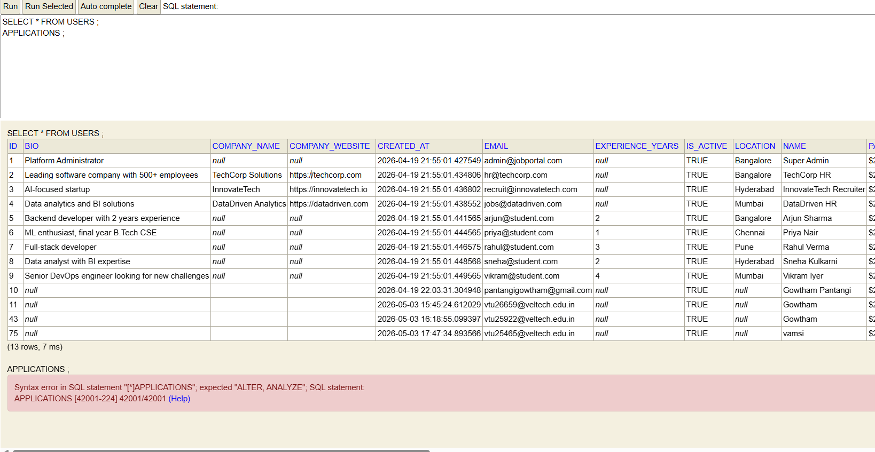
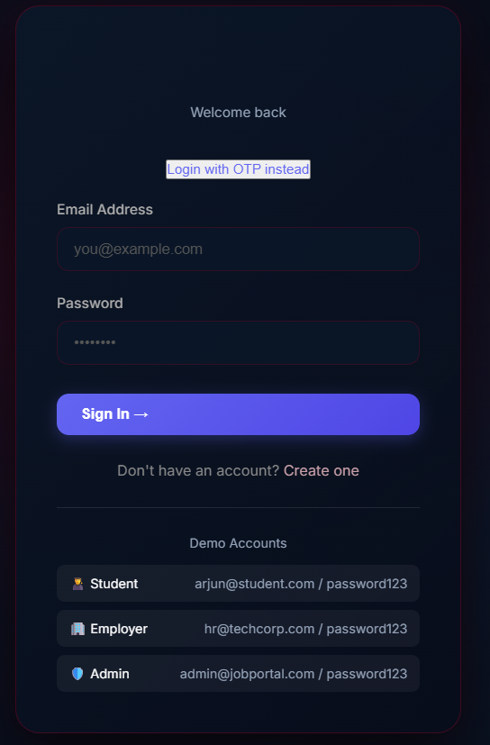
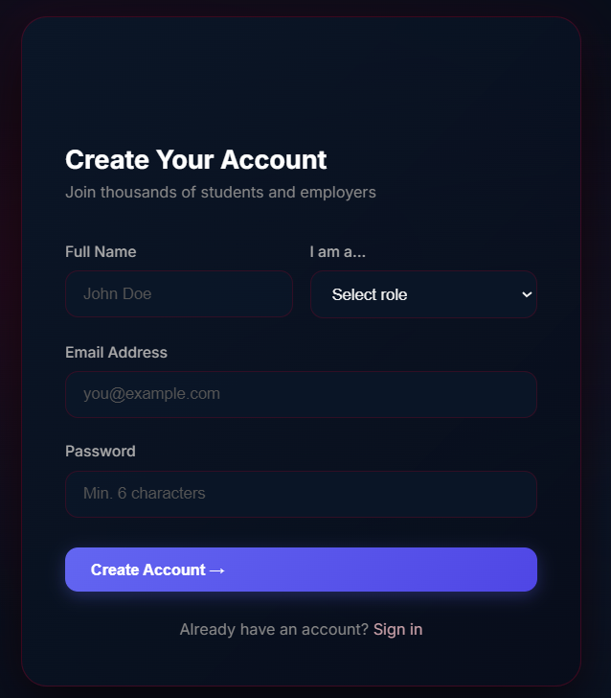

IMPLEMENTATION SCREENSHOTS
1
2
3
4
5
6
7
8
9

Slide 11
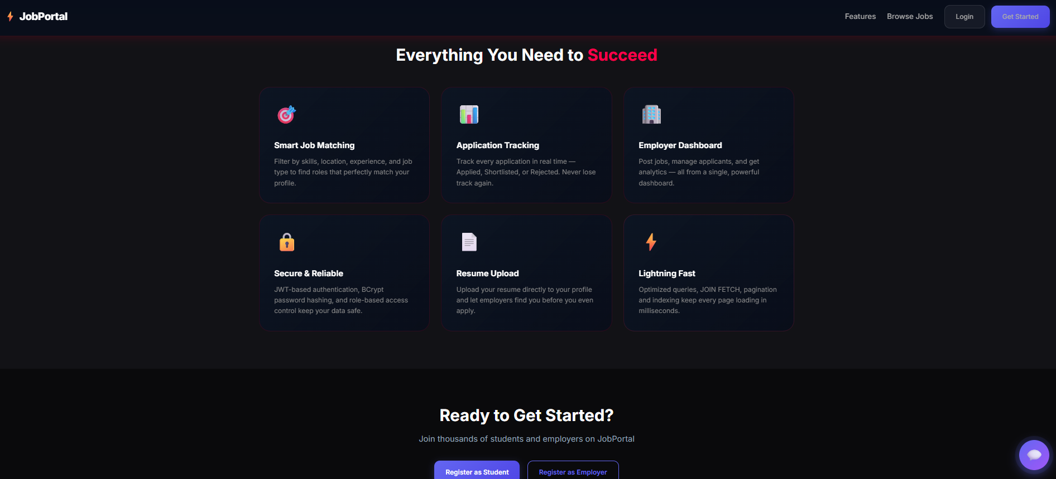
IMPLEMENTATION SCREENSHOTS
Displays the main landing page of JobPortal with key features like job search, employer connections, and user navigation options.
Provides an intuitive user interface with quick access buttons for job browsing, posting, and user interaction.
1
2
3
4
5
6
7
8(A)
9

Slide 12
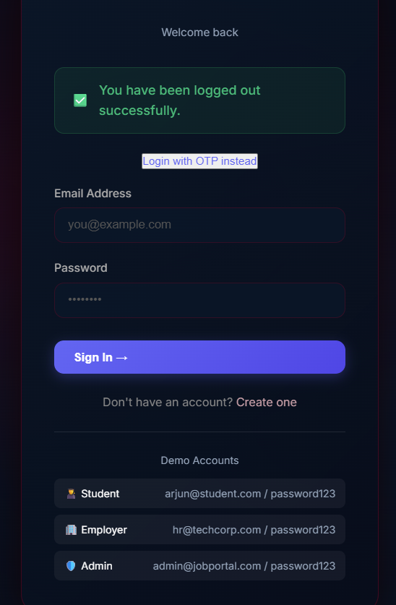
IMPLEMENTATION SCREENSHOTS
Admin & User Login Page
1
2
3
4
5
6
7
8(B)
9

Slide 13
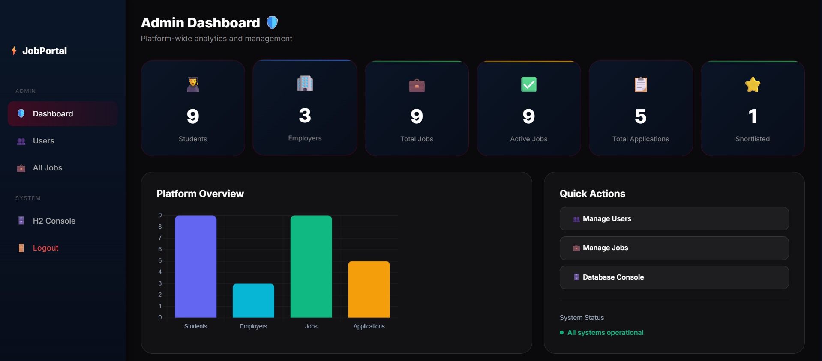
IMPLEMENTATION SCREENSHOTS
Admin Dashboard Screenshot
1
2
3
4
5
6
7
8(C)
9

Slide 14
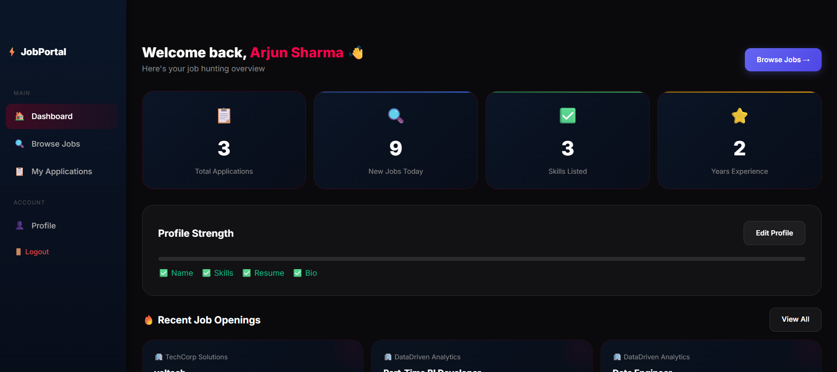
IMPLEMENTATION SCREENSHOTS
USER DASHBOARD Screenshot
1
2
3
4
5
6
7
8(C)
9

Slide 15
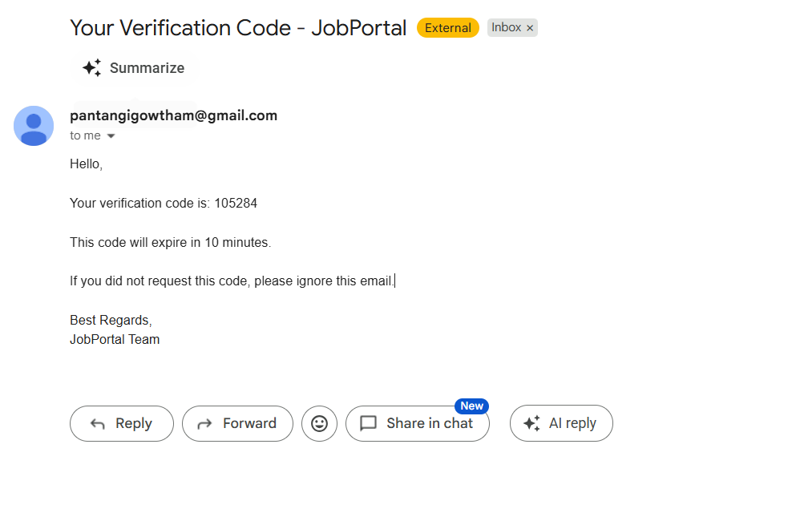
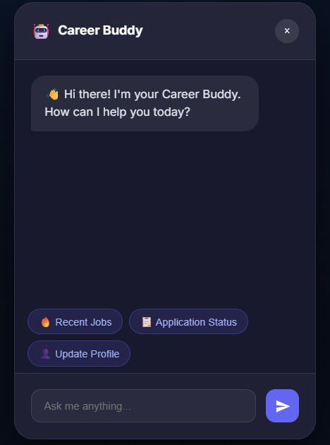
IMPLEMENTATION SCREENSHOTS
Innovative Module
Displays OTP-based email verification system, ensuring secure user authentication during login/registration.
Shows chatbot (Career Buddy) interface, providing instant assistance like job search, application status, and profile updates.
1
2
3
4
5
6
7
8(C)
9

Slide 16
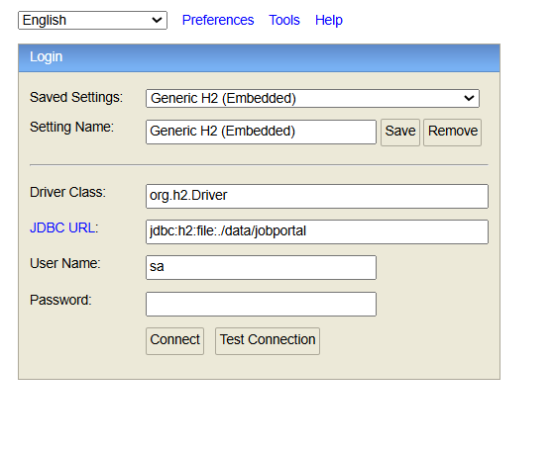
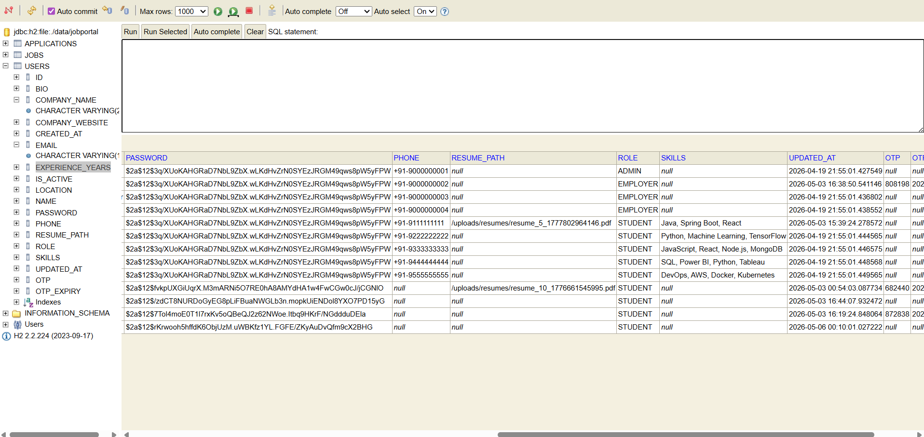
IMPLEMENTATION SCREENSHOTS
Database Screenshot
Displays H2 database tables with stored data such as users, jobs, and applications, ensuring structured data management.
Demonstrates data storage, retrieval, and integrity, supporting efficient backend operations of the JobPortal system.
1
2
3
4
5
6
7
8(C)
9

Slide 17
ADVANTAGES & LIMITATIONS
1
Advantages:
Provides a centralized platform for students, employers, and admin
Automates recruitment process, reducing manual effort and time
Ensures secure authentication using JWT and OTP verification
Enables real-time job application tracking and updates
Improves user experience with chatbot and notifications
Limitations:
Currently uses H2 database, not suitable for large-scale deployment
Limited to web application (no mobile app support)
Chatbot functionality is basic and rule-based
Performance may reduce with high user load
2
3
4
5
6
7
8
9

Slide 18
Thank you

